Slide 1


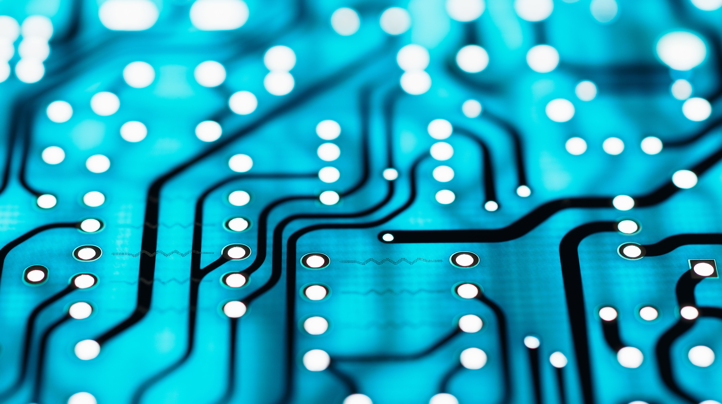
Cryptfalcon auto trader
Andrew Martin

Slide 2
What is CryptFalcon?
Automated Cryptocurrency Manager
Graphical Interface
Automated and Manual Transactions Supported
Notes:
Cryptfalcon is a tool that I built to automate cryptocurrency trading. It analyses crypto prices, predicts lows and highs, and automatically makes buy and sell orders to make a profit. It can be used to evaluate crypto prices, make manual transactions, simulate trading given historical data, and automatically purchase coins.

Slide 3

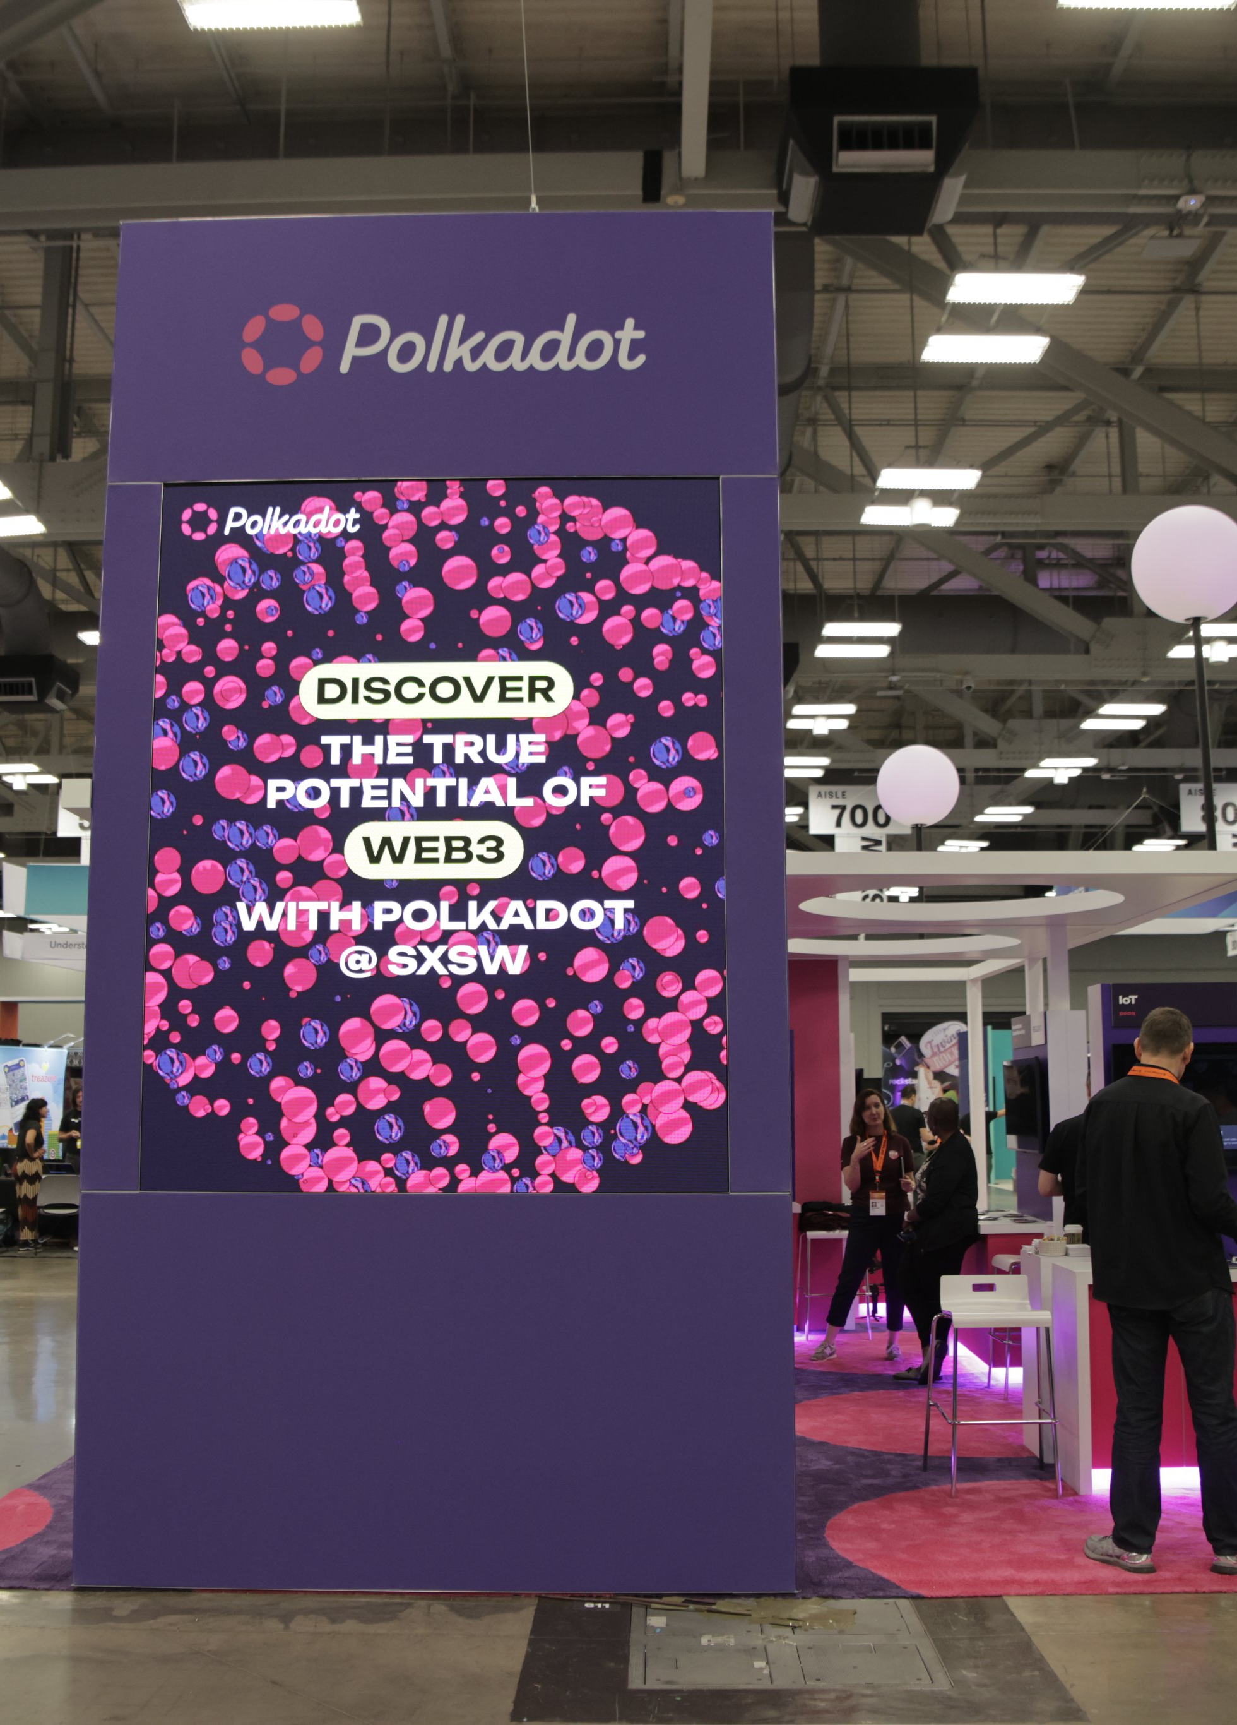
Inspiration
Started Researching Cryptocurrencies in High School
Started Research and Work on CryptFalcon Last Semester
First Iteration Completed Winter Break
SXSW Polkadot Booth
Watr – Commodities On-chain
Nodle – Decentralized IOT
https://twitter.com/Polkadot/status/1635019453112156161/photo/3
Notes:
I was still in highschool when I first heard about blockchain. This time last year, I saw Derek’s presentation on NFTs and wanted to learn more about Cryptocurrencies. Soon, I began trading for fun, and cryptfalcon followed soon after. I finished my first version in January, and the rough cut was able to usually not lose money. In March, I was further inspired at south by southwest, where I networked at the booth for a blockchain protocol called polkadot. Since then, I have been working on my second version, which I have ready today.

Slide 4

Learning Process
Investment Strategies
Linear Analysis with Hard Limits → MACD Strategy Using Moving Averages
Python Modules
Big Data Analysis
Binance API
MultiProcessing
Graphical Interface Using Tkinter
Notes:
During development, I learned a ton. When I started simulating trades, I was using a very basic algorithm. My current version has a much more accurate algorithm that uses moving averages to predict market swings. In addition to trading strategies, I taught myself a few new modules in python, the programming language I used. One of my favorite moments was learning to turn my program into a desktop application with entry fields and working buttons.

Slide 5
DEMO

Slide 6
Future Improvements
Increase Polling Rate from 15 Minutes to 1 Minute
Improve Peak Detection
More Accurate Stop Losses
General Cleanup

Slide 7
THANK YOU!

